Slide 1
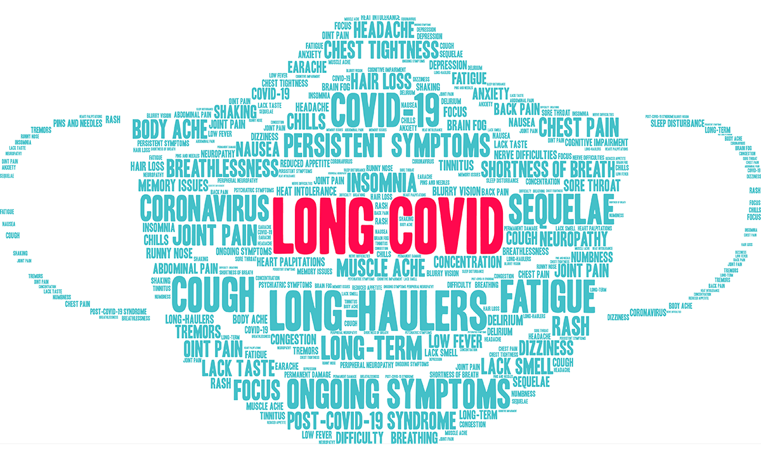

Slide 2
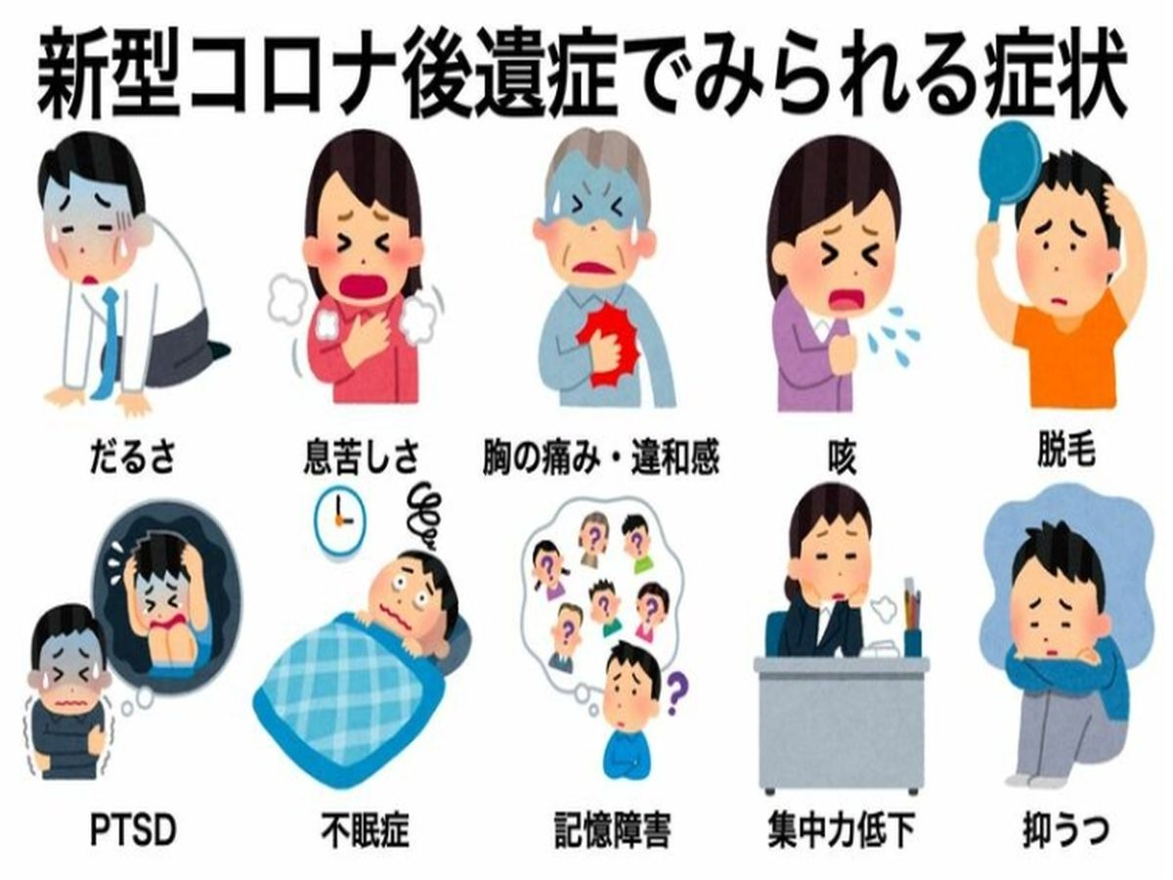
Notes:
2021.5.4

Slide 3
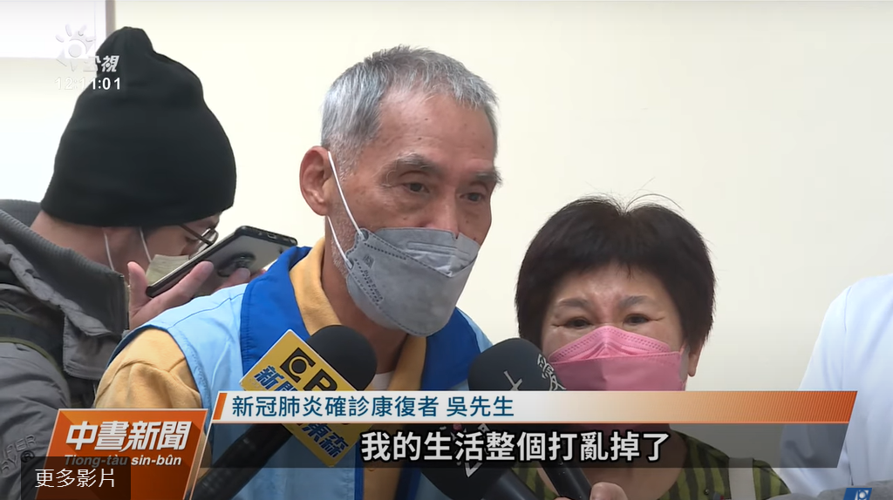
「待在家就變成了憂鬱症，睡覺睡不著，食慾也不好，瘦了10公斤，我的生活整個打亂掉了。」
Notes:
t.ly/BOVu

Slide 4
根據健保署分析，
有八成患者飽受後遺症之苦
疲倦、呼吸喘、胸痛、關節痛、掉髮、神經肌肉病變等症狀
Notes:
2021-12-27

Slide 5
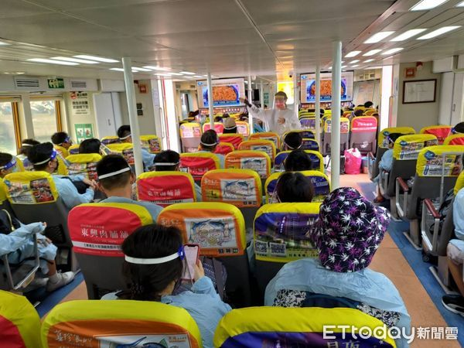
4/10(日)專船接送，86位接觸者PCR結果陰性

Slide 6
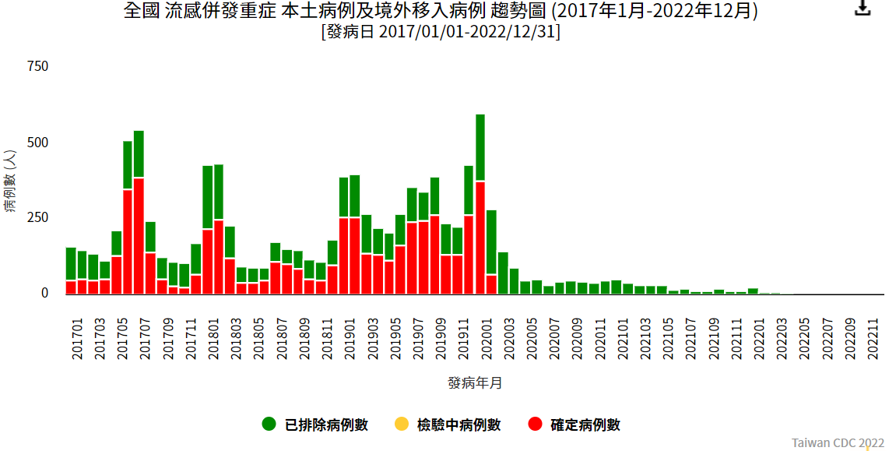
全民戴口罩 去年僅1例流感重症、腸病毒掛0

Slide 7
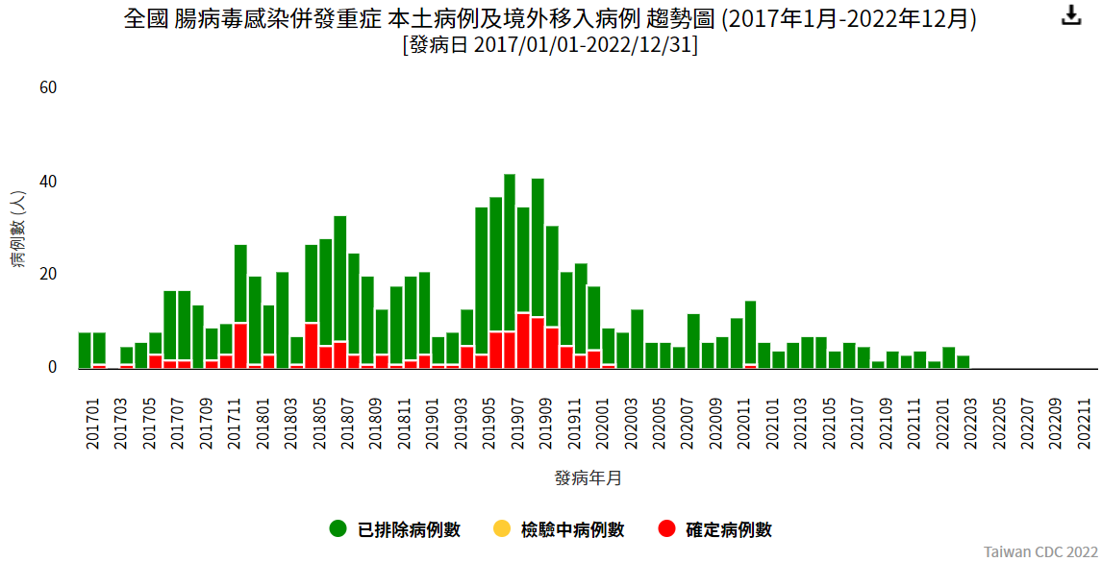

Slide 8
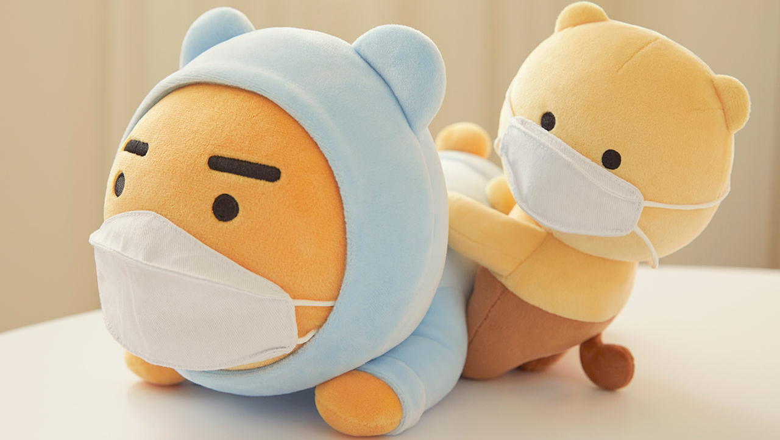
為了你，我願意戴口罩
Notes:
https://www.ettoday.net/news/20220410/2226575.htm
2022年04月10日 15:53

Slide 9
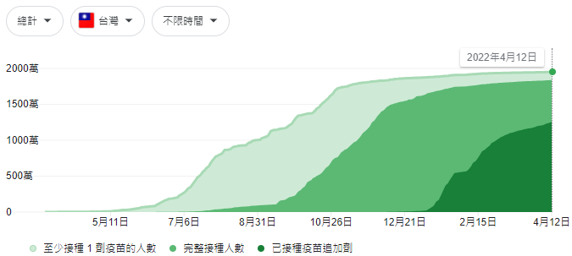

Slide 10
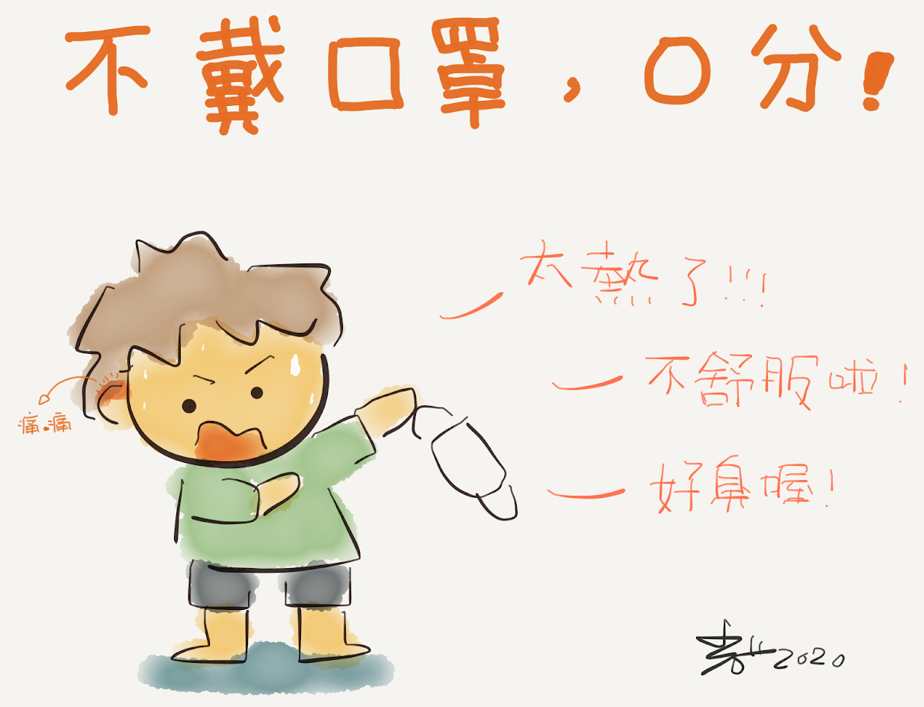
Notes:
109國中教育會考
https://news.pts.org.tw/article/480133

Slide 11
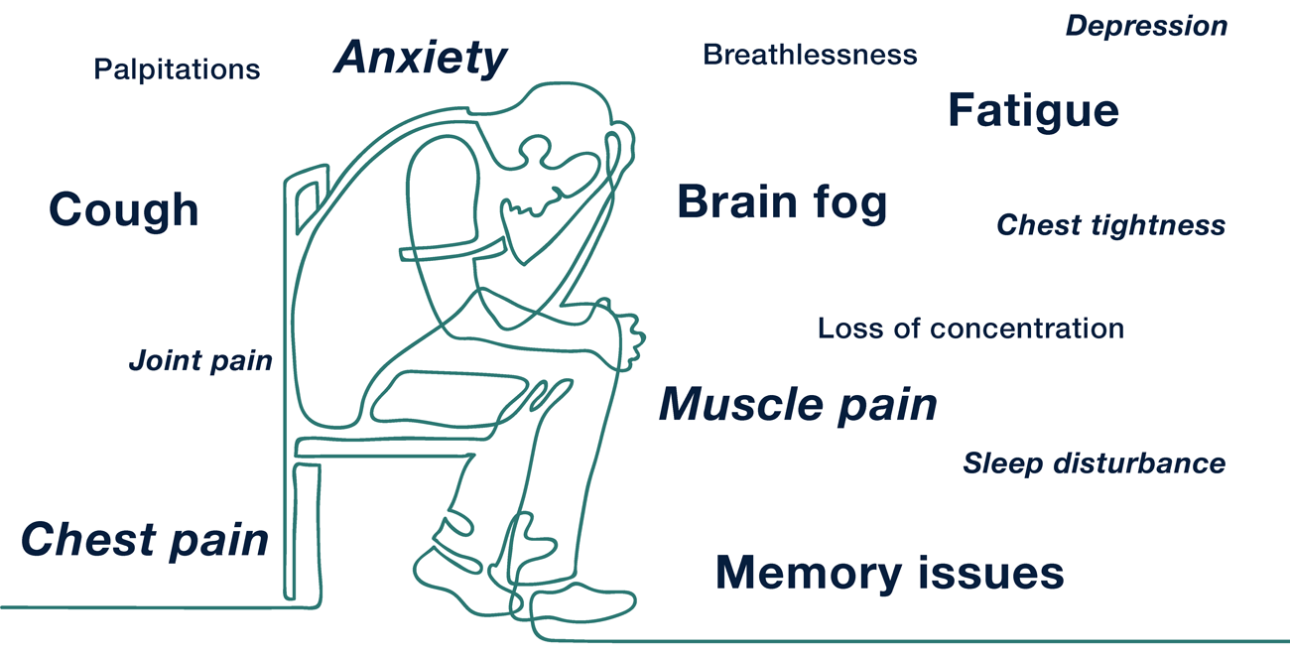
Notes:
https://www.psychiatrycentre.co.uk/treatments/long-covid/
Breathlessness
Cough
Chest tightness
Chest pain
Palpitations
Fatigue
Symptoms of depression
Symptoms of anxiety
Joint and/or muscle pain
Brain fog
Loss of concentration
Memory issues
Sleep disturbance

Slide 12
Long COVID affects 1 in 5 people following infection. Vaccination, masks and better indoor air are our best protections
Notes:
https://theconversation.com/long-covid-affects-1-in-5-people-following-infection-vaccination-masks-and-better-indoor-air-are-our-best-protections-180668

Slide 13
Many patients recover from COVID within a week or two, but at least one in five experience persistent or new symptoms more than four weeks after first being diagnosed.

Slide 14
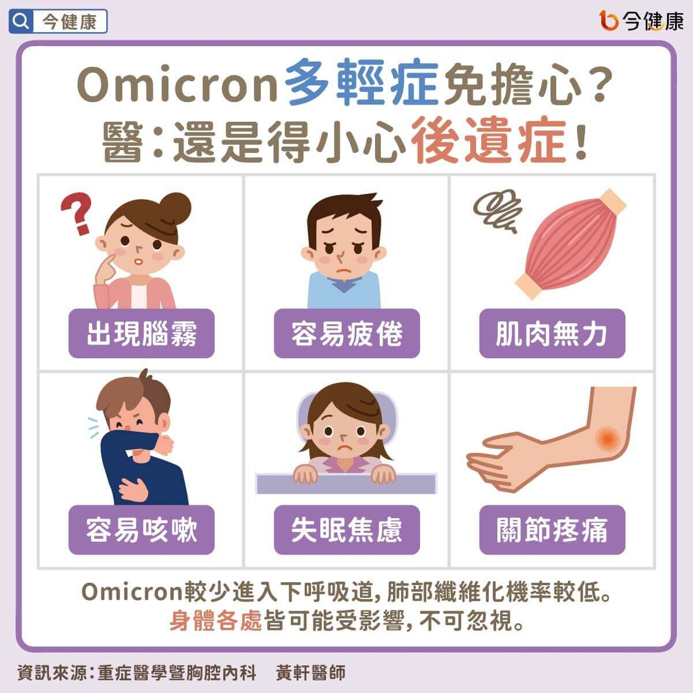
Notes:
https://gooddoctorweb.com/post/1224

Slide 15
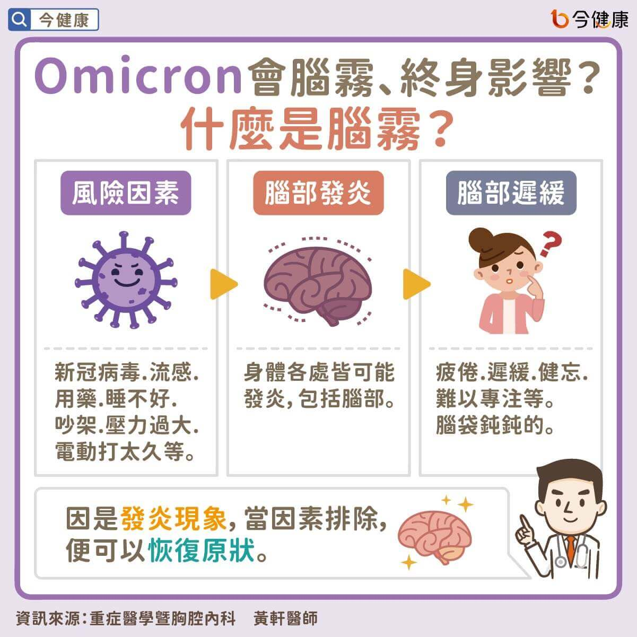

Slide 16
